Slide 1

Phase 2 Progress Report
MediSim
Multimodal Diagnostic & Agentic Triage System
CNN-BiLSTM Fusion
•
Multi-Agent Verification
Htut Ko Ko • Michael R. Lacar
Asian Institute of Technology
Imtiaz Ahmad • Aashutosh Raut
NLP Project

Slide 2
Project Overview
The Problem & MediSim Solution
THE PROBLEM
MEDISIM SOLUTION
Fragmented Systems
Feature A: Multimodal Fusion
Medical imaging and triage operate as separate pipelines
CNN + BiLSTM for chest X-ray + symptom classification
LLM Limitations
Feature B: Multi-Agent Triage
End-to-end LLMs are computationally dense and hallucination-prone
Nurse → Specialist → Fact-Checker via LangChain + Gemini
Missing Verification
Self-Verification
No cross-verification layer for clinical safety
Grounded outputs with deterministic model anchoring
Goal: Unified, cross-verified clinical pipeline on consumer hardware
M-series / Cuda GPU

Slide 3
Literature Review
Key Insights from 16 ACL Anthology Papers
Agentic LLM Triage & RAG
Multimodal X-Ray & NLP
Lu et al. (2024) TriageAgent
↓18.42%
5-stage multi-agent LLM framework with RAG
Bu et al. (2024)
SOTA
Discordance: 18.98% vs. human 31.43%
Dynamic Knowledge Prompt (DKP) for lesion grounding
Relevance: Direct inspiration for multi-agent roles
Relevance: Direct blueprint for image-to-report pipeline
Sahu et al. (2025) OccuTriage
↓3.1%
Wang et al. (2023)
V-L
Two-crew agent with iterative majority voting
Fine-grained vision-language contrastive learning
Under-triage: Reduced to 3.1%
Relevance: Lesion-level feature alignment
Relevance: Safety-first defaulting logic
Liu et al. (2021)
+14-17%
Xiong et al. (2024) MEDRAG
↑1-18%
Contrastive Attention (CA) model for anomaly detection
Medical RAG toolkit evaluation
Relevance: Efficient attention without large LLMs
Relevance: Optimal corpus-retriever selection
Mullenbach et al. (2018)
P@8=0.71
Wu et al. (2025) MedGraphRAG
SOTA
CAML: Attentional CNN for medical code prediction
Graph-based RAG with top-down retrieval
Relevance: Primary CNN classification baseline
Relevance: Evidence-backed verification

Slide 4
Research Framework
Research Questions & Variables
RQ1
Multimodal Performance
RQ2
Hallucination Reduction
RQ3
Latency & Efficiency
How effectively does a lightweight vision-language fusion model align medical images with textual symptoms compared to unimodal baselines?
To what extent does a multi-agent LLM framework minimize hallucination and omission errors in clinical triage compared to a single-agent baseline?
Does the combination of local lightweight models and API-based LLMs provide a computationally viable diagnostic system for low-resource environments?
IV: Model Modality & Agent Configuration
DV: Classification Accuracy & Hallucination Rates
Independent Variables
Dependent Variables
Research Questions
2
2
3

Slide 5
System Architecture
Dual-Pipeline Design
Feature A
Feature B
Vision-Language Fusion
Multi-Agent Triage
CNN Image Encoder
1
Triage Nurse
ResNet-18 for feature extraction
Shared Infrastructure
Symptom gathering & assessment
React / Firebase
BiLSTM Text Encoder
2
Specialist Doctor
GloVe / Word2Vec embeddings
PyTorch (CNN/BiLSTM)
Differential diagnosis & recommendations
LangChain + Gemini
Diagnostic Report
IU X-Ray Dataset
3
Fact-Checker
Class Probs + Confidence
Cross-validation against guidelines
Consumer GPU / Apple Silicon
Verified Clinical Next Steps

Slide 6
Feature A
Vision-Language Fusion Architecture
Architecture Flow
Dataset
IU X-Ray (Kaggle)
Chest X-rays + Reports
ResNet-18 CNN
+
BiLSTM Network
Image feature extraction
Text embedding (GloVe/W2V)
Train / Val / Test
70% / 15% / 15%
Preprocessing
Dense Layer Concatenation
Feature fusion → Classification Head
Images: rescaling, normalization, augmentation
Text: tokenization, lowercasing, embeddings
Diagnostic Report Output
Evaluation Metrics
Class Probabilities + Confidence Scores
Accuracy
Precision
Recall
F1-Score

Slide 7
Feature B
Multi-Agent Triage Framework
Agent Orchestration
Tech Stack
LLM Engine
Triage Nurse Agent
Stage 1
Gemini 2.5 Flash
Role: Initial patient interaction & symptom gathering
Symptom Collection
Initial Assessment
Framework
LangChain Orchestration
Knowledge Base
Specialist Doctor Agent
Stage 2
Clinical Guidelines RAG
Role: Differential diagnosis & treatment recommendations
Diagnosis
Treatment Plan
Evaluation
Hallucination Rate vs. Baseline
Fact-Checker Agent
Stage 3
Discordance Rate Measurement
Role: Cross-validation against clinical guidelines
Human-in-the-Loop Scoring
Safety Verification
RAG Integration
Latency: < 2s per turn
Safety-First Defaulting
Conservative triage when uncertain

Slide 8
Project Timeline
Phase Progress & Milestones
DONE
DONE
NOW
NEXT
Phase 1
Phase 2
Phase 3
Phase 4
Literature Review
Proposal & Design
Implementation
Deployment
16 ACL papers synthesized
Dual-pipeline architecture
Repo scaffolded (9 commits)
Ablation studies
4 thematic clusters
ACL-format report
Notebooks initiated
Human-in-the-loop
Baselines identified
Presentation deck
IU X-Ray pipeline
Final paper write-up
Model training
System deployment

Slide 9
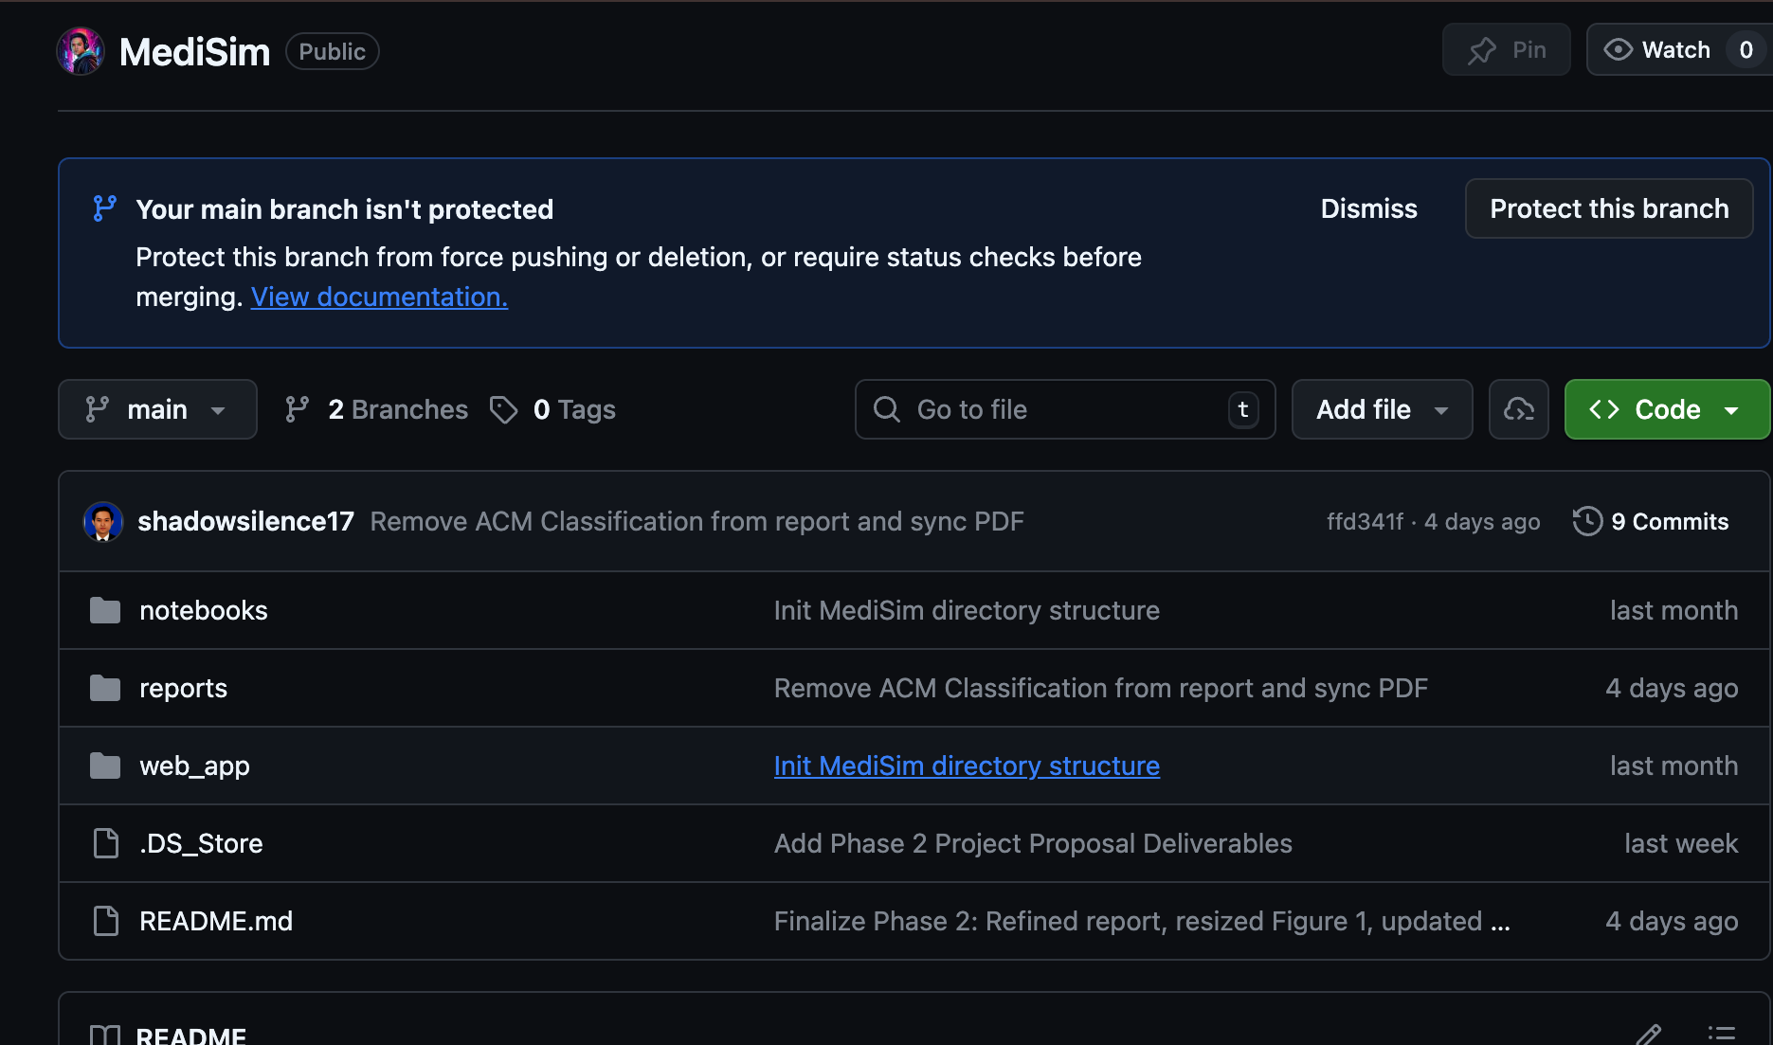
Phase 3 Status
Implementation Progress & Repository
Repository Stats
Tech Stack
Phase 3 Checklist
Models
Phase 2 report committed
PyTorch · ResNet-18 · BiLSTM
ACL-format PDF & LaTeX
Embeddings
Repository scaffolded
GloVe / Clinical Word2Vec
Directory structure active
Agents
README documentation
github.com/shadowsilence94/MediSim
Full project docs complete
LangChain · Gemini 2.5 Flash
Notebooks initialized
Web App
Baseline pipelines started
Structure
React based Front end with Fast API backend
notebooks/
In Progress
Streamlit skeleton
Dataset
Web app scaffold started
web_app/
In Progress
IU X-Ray (Kaggle)
reports/Phase2/
✓ Committed
IU X-Ray data pipeline
Evaluation
In progress
data/
Placeholder
BLEU · ROUGE · F1 · Human-HITL
CNN & BiLSTM baselines
Training pending

Slide 10
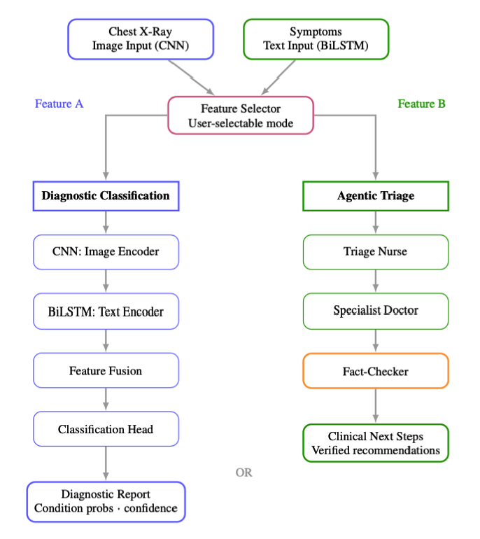
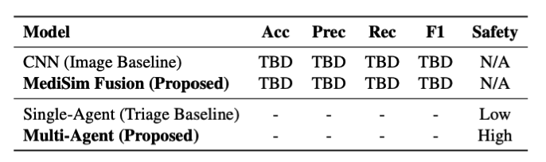
Expected Outcomes
Baseline vs. MediSim Architecture Comparison
Dimension
Baseline
MediSim (Proposed)
Modality
Unimodal (text or image only)
Multimodal: Text + Image Fusion
Architecture
Single-stage classification
Two-stage: Vision-Language + Multi-Agent
Reasoning
Limited, static classification
Advanced: multi-agent debate & verification
Error Handling
Single point of failure
Robust: cross-verification via Fact-Checker
Scalability
Low, rigid architecture
High: modular, independently upgradable agents
UX Mode
Static report output
Interactive: conversational triage interface
Evaluation
BLEU / ROUGE metrics only
BLEU / ROUGE + Human-in-the-loop coherence
Hypothesis
Multi-agent architecture expected to lower clinical discordance rates by ≥15% vs. standalone LLM baselines, consistent with TriageAgent (Lu et al., 2024) findings.

Slide 11

Next Steps
Immediate Actions & Core Contributions
Immediate Actions
Core Contributions
1
Complete IU X-Ray Pipeline
Unified Multimodal Architecture
Data preprocessing & augmentation
CNN-BiLSTM fusion aligning radiology with symptoms
2
Train CNN Baseline
Role-Based Verification Protocol
ResNet-18 image encoder
Multi-agent framework mitigating clinical hallucinations
3
Train BiLSTM Baseline
Lightweight Edge-Deployable System
GloVe/Word2Vec text encoder
Consumer-grade hardware feasibility (M-series / RTX)
4
Integrate Fusion Head
Grounded Generative Outputs
Concatenation & classification
Deterministic Feature A anchors Feature B agents
5
Implement Agent Orchestration
LangChain + Gemini 2.5 Flash
Asian Institute of Technology — NLP Project
MediSim: Multimodal Diagnostic & Agentic Triage System

Slide 12
2
THANK YOU!
3
4
Asian Institute of Technology — NLP Project
MediSim: Multimodal Diagnostic & Agentic Triage System

